Slide 1


Accenture North America Data Analysis Project

Slide 2


Today's agenda
Project recap
Problem
The Analytics team
Process
Insights
Summary

Slide 3

Every day over 100,000 pieces of content, ranging from text, images, videos and GIFs are posted. All of this data is highly unstructured and requires extremely sophisticated and expensive technology to manage and maintain.
To start our engagement with Social Buzz, we are running a 3 month initial project in order to prove to them that we are the best firm to work with. They are expecting the following: -
An audit of their big data practice
Recommendations for a successful IPO
An analysis of their content categories that highlights the top 5 categories with the largest aggregate popularity
Project Recap

Slide 4

Problem
Over 100K Posts Per Day!
3.6 Million Pieces of Content Per Year!
How to handle such a problem at scale?
Need to find most popular content categories.

Slide 5



Mae Mulligan
Managing Director
Who Are With Me In The Analytics Team
Marcus Rompton
Senior Principal
Andrew Fleming
Chief Technical Architect

Slide 6
Data Understanding
Process
1
Data Cleaning
2
Data Modeling
3
Data Analysis
4
5
Data Insights

Slide 7
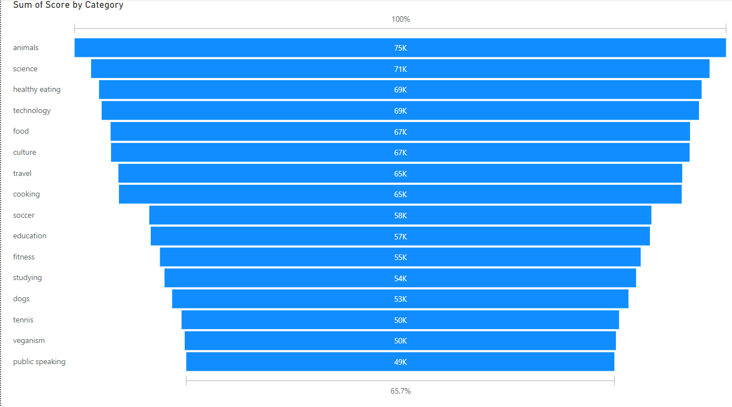

Insights

Slide 8
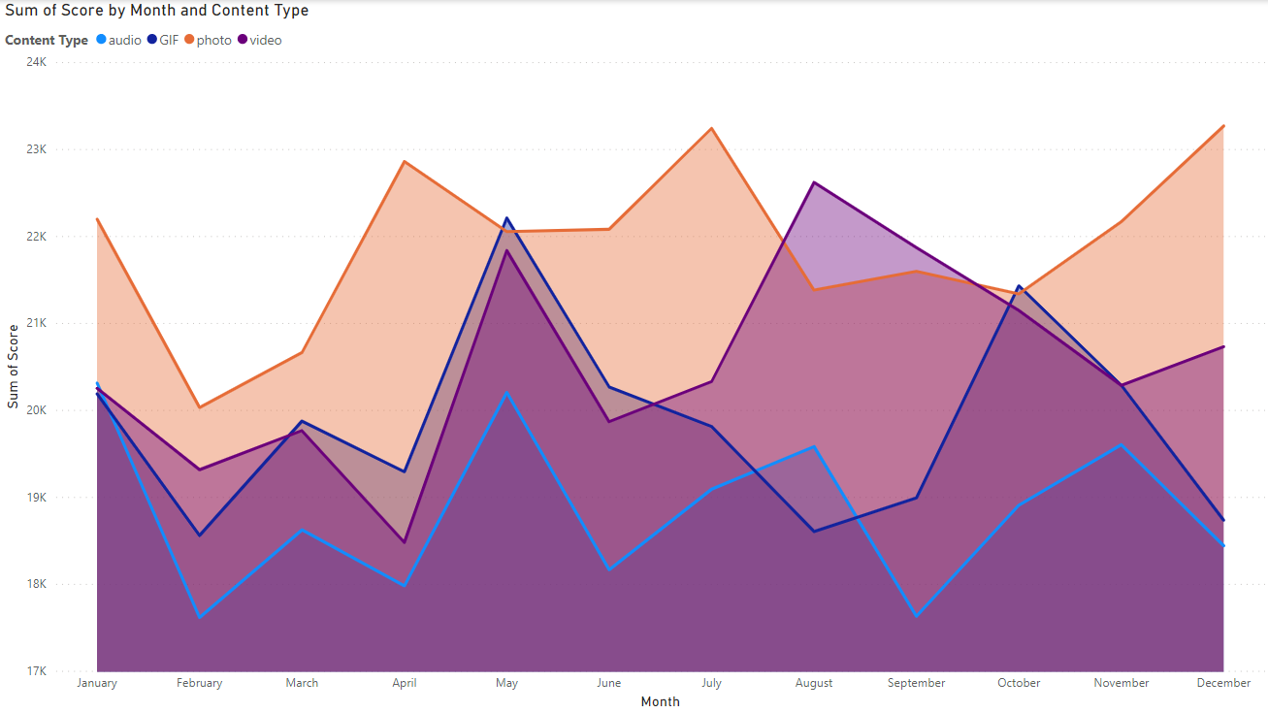
Insights

Slide 9
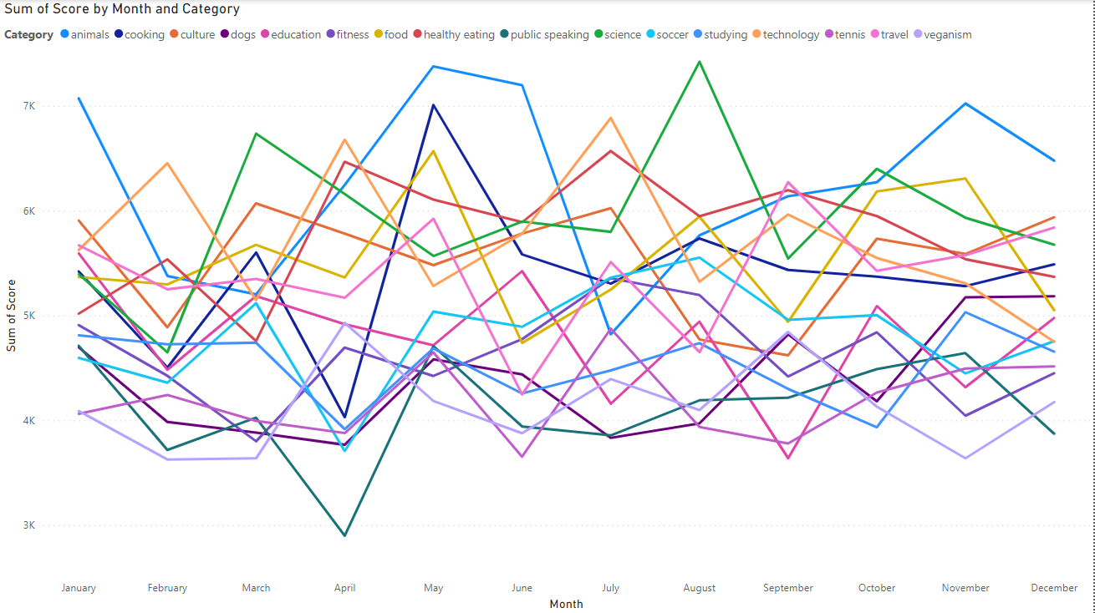
Insights

Slide 10

Top 5 Content Categories:
Animals
Science
Healthy Eating
Technology
Food
Summary

Slide 11
Thank you!
ANY QUESTIONS?

